Slide 1
The Greedy Approach
Xu Yanyan

Slide 2
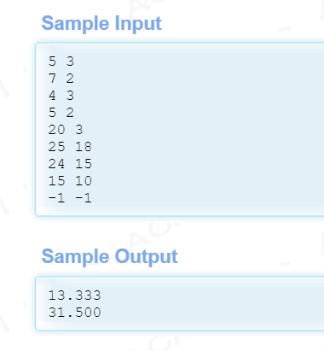
Example
https://acm.hdu.edu.cn/showproblem.php?pid=1009

Slide 3
The Greedy Approach
Algorithms for optimization problems typically go through a sequence of steps, with a set of choices at each step.
A greedy algorithm always makes the choice that looks best at the moment.
It makes a locally optimal choice in the hope that this choice will lead to a globally optimal solution.
Greedy algorithms do not always yield optimal solutions (travelling salesman problem), but for many problems they do.
If a greedy algorithm can be proven to yield the global optimum for a given problem class, it typically becomes the method of choice because it is faster than other optimization methods like dynamic programming which makes decisions based on all the decisions made in the previous stage.

Slide 4
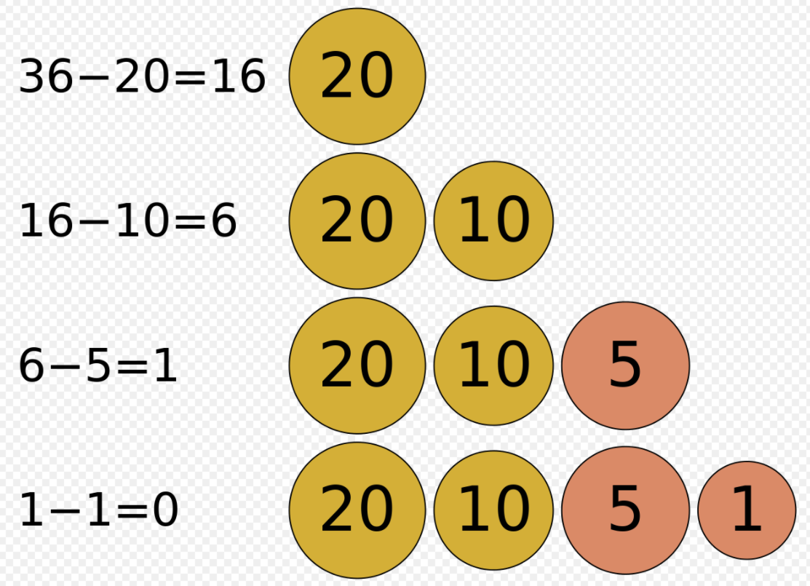
Example (optimal ): the change-making problem
Greedy algorithms determine minimum number of coins to give while making change.
In general, the change-making problem requires dynamic programming to find an optimal solution; however, most currency systems, including the RMB, Euro and US Dollar, are special cases where the greedy strategy does find an optimal solution.
{1,2,4,5,6}, 9 (greedy, 6,2,1) (dp, 4,5)

Slide 5
#include <iostream>
using namespace std;
#define NUM 3
const int Value[NUM] = {5, 2, 1}; // descending order
int main(){
int i, money;
int ans[NUM]={0};
cin >> money;
for(i= 0; i < NUM; i++){
ans[i] = money/Value[i];
money = money - ans[i]*Value[i];
}
for(i= 0; i < NUM; i++)
cout<<Value[i]<<" "<<ans[i]<<endl;
return 0;
}

Slide 6
Example (not optimal)

Slide 7
Applications
Examples of such greedy algorithms are Kruskal's algorithm and Prim's algorithm for finding minimum spanning trees, and the algorithm for finding optimum Huffman trees.
Dijkstra's algorithm and the related A* search algorithm are verifiably optimal greedy algorithms for graph search and shortest path finding.
A* search is conditionally optimal, requiring an "admissible heuristic" that will not overestimate path costs.
The activity selection problem is characteristic to this class of problems, where the goal is to pick the maximum number of activities that do not clash with each other.

Slide 8
Two easy problems
Given n items, the weight and value of the i-th item are w[i] and v[i] respectively. Compute the total value as high as possible under the condition that the total weight does not exceed C. Each item can be taken away proportionally.
Given n persons, the weight of the i-th person is w[i]. The maximum load capacity of a ship is C, and it can only take two persons once at most. Load everyone with the least number of ships.

Slide 9
Problems
The activity selection problem
Tian Ji -- The Horse Racing
Physical Examination
Solving problems by using Huffman coding
Entropy
Add All
Gone Fishing

Slide 10
The activity selection problem
The activity selection problem is a combinatorial optimization problem concerning the selection of non-conflicting activities to perform within a given time frame, given a set of activities each marked by a start time (si) and finish time (fi).
The problem is to select the maximum number of activities that can be performed by a single person or machine, assuming that a person can only work on a single activity at a time.
A classic application of this problem is in scheduling a room for multiple competing events, each having its own time limit (start and finish time).

Slide 11
Formal definition
Assume there exist n activities with each of them being represented by a start time si and finish time fi. Two activities i and j are said to be non-conflicting if si ≥ fj or sj ≥ fi. The activity selection problem consists in finding the maximal solution set (S) of non-conflicting activities.

Slide 12
For example: there are 11 activities.
i
1
2
3
4
5
6
7
8
9
10
11
s_{i}
1
3
0
5
3
5
6
8
8
2
12
f_{i}
4
5
6
7
8
9
10
11
12
13
14

Slide 13
Greedy Choice
Earliest start time: wrong. If an activity does not terminate (for example, the first one), the following activities cannot start.
Earliest finish time: right
The shortest: wrong

Slide 14
3
2
2, 3 conflict with 1
1
4
1
4
4, 1 not conflict
7
6
5, 6, 7 conflict with 4
5
1
4
8
1
4
8
8, 4 not conflict
10
9
9, 10 conflict with 8
1
4
8
11
1
4
8
11
11, 8 not confilict
0 1 2 3 4 5 6 7 8 9 10 11 12 13 14

Slide 15
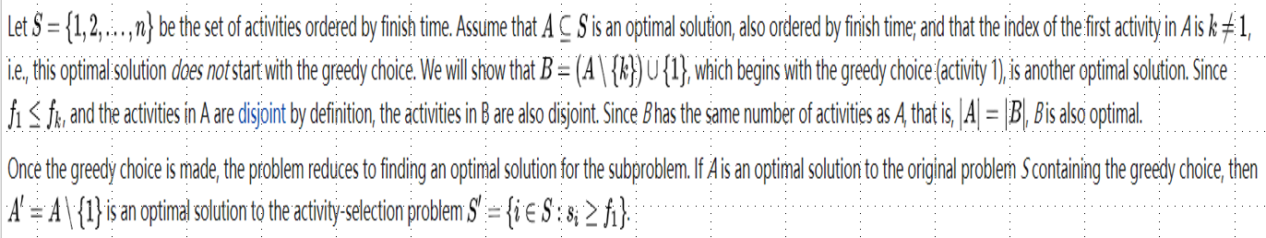
Proof of optimality

Slide 16
Conclusions
The greedy strategy of choosing the earliest finish time can get an optimal solution.
The greedy strategy of choosing the latest start time can also get an optimal solution.
Solution is not unique.

Slide 17
Horse Racing

Slide 18
Greedy Strategy
If Tian Ji’s fastest horse is faster than Qi’s fastest horse, then these two horses race.
Proof: The previous strategy is T1 vs Q1 & Tj vs Qi ; If there is a better strategy, under which T1 vs Qi & Tj vs Q1, then we get
T1
Q1
Tj
Qi
Condition | previous | new
Tj > Qi | 2 | 1+sign(Tj-Q1)
Tj = Qi | 1 | 1+sign(Tj-Q1){-1,0}
Tj < Qi | 0 | 0

Slide 19
Greedy Strategy
If Tian Ji’s fastest horse is slower than Qi’s fastest horse, then Tian Ji’s slowest horse and Qi’s fastest horse race.
Proof: The previous strategy is Tn vs Q1 & Tj vs Qi ; If there is a better strategy, under which Tj vs Q1 & Tn vs Qi, then we get
T1
Q1
Tj
Qi
condition | previous | new
Tj > Qi | 0 | -1+sign(Tn-Qi)
Tj = Qi | -1 | -1+sign(Tn-Qi){-1,0}
Tj < Qi | -2 | -2
Tn

Slide 20
Greedy Strategy
If the fastest horses are equal, compare Tian Ji’s slowest horse with Qi’s slowest horse:
If Tian Ji’s slowest horse is faster than Qi’s slowest horse, they race.
T1
Q1
condition | previous | new
Tj > Qi | 2 | 1+sign(Tn-Qi)
Tj = Qi | 1 | 1+sign(Tn-Qi){-1,0}
Tj < Qi | 0 | 0
Tj
Qi
Tn
Qn

Slide 21
Greedy Strategy
If the fastest horses are equal, compare Tian Ji’s slowest horse with Qi’s slowest horse:
If Tian Ji’s slowest horse is not faster than Qi’s slowest horse, then Tian Ji’s slowest horse and Qi’s fastest horse race.
T1
Q1
condition | previous | new
Tj > Qi | 0 | -1+sign(Tj-Q1)
Tj = Qi | -1 | -1+sign(Tj-Q1){-1,0}
Tj < Qi | -2 | -2
Tj
Qi
Tn
Qn

Slide 22
Physical Examination

Slide 23
Consider there are only two subjuects (a_{i},b_{i}),(a_{j},b_{j}):
T_{ij} = a_{i} + a_{i}b_{j} + a_{j}
T_{ji} = a_{j} + a_{j}b_{i} + a_{i}
T_{ij} <= T_{ji} when a_{i}b_{j}<=a_{j}b_{i}, that is, a_{i}/b_{i}<=a_{j}/b_{j}
When n>2
T+ a_{i} + b_{i}T +a_{j}+Tb_{j}+a_{i}b_{j} + b_{i}b_{j}T
T+ a_{j} + b_{j}T +a_{i}+Tb_{i}+a_{j}b_{i} + b_{j}b_{i}T
Still, a_{i}b_{j}<=a_{j}b_{i} means a_{i}/b_{i}<=a_{j}/b_{j}
Sort according to a_{i}/b_{i}

Slide 24
STL-sort()
struct test{
double a;
string b;
};
bool cmp(test t1, test t2){
if(fabs(t1.a-t2.a)>0.000001)
return t1.a>t2.a;
return t1.b>t2.b;
}

Slide 25
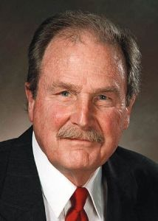
Huffman coding
A Huffman code is a particular type of optimal prefix code that is commonly used for lossless data compression.
Using a greedy approach

Slide 26
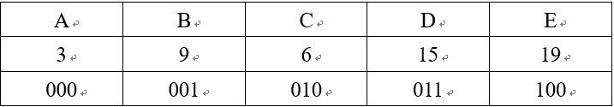
Simple coding
A string of characters only contains the five types of characters A, B, C, D, and E. The characters’ frequencies are different.
Simple coding:
Each character is represented using 3 bits, and the total length is 3*(3+9+6+15+19) = 156

Slide 27
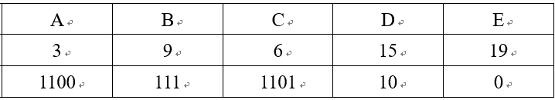
Variable-length coding
Characters with more occurrences are represented by short codes, and characters with less occurrences are represented by long codes.
The length is: 3*4 + 9*3 + 6*4 + 15*2 + 19*1 = 112
Compared with the simple coding, the compression ratio is 156/112=1.39.

Slide 28
Basic requirements: The bit string representing some particular symbol is never a prefix of the bit string representing any other symbol.
Both simple coding and variable-length coding methods are correct. For example, after decoding “1100 111 10 0 1101”, uniquely get "ABDEC”.

Slide 29
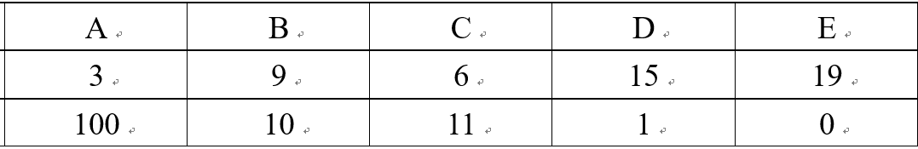
Wrong coding:
For “100”, is it “A” or “BE” or "DEE”?
It is not prefix-free.

Slide 30
Optimal coding
Is there a better coding method than the previous variable-length coding method?
Given a string, the goal is to encode it to minimize the total length after encoding, that is, to get an optimal solution.
Using Huffman coding

Slide 31
Huffman coding uses a greedy approach to construct a binary coding tree.

Slide 32
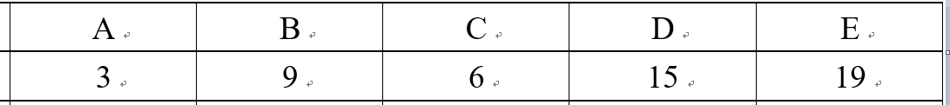
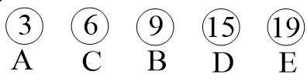
The greedy approach
Sort by frequencies:

Slide 33
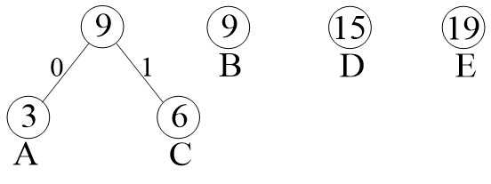
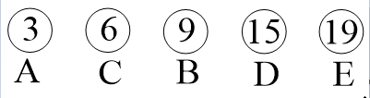
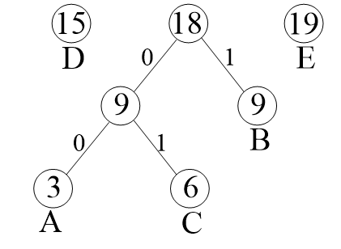
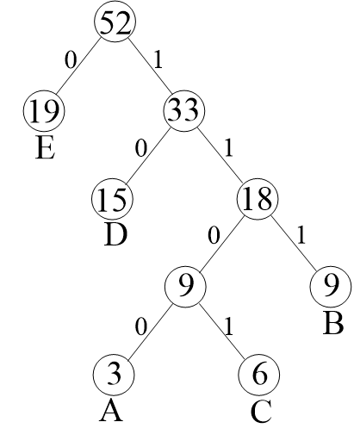
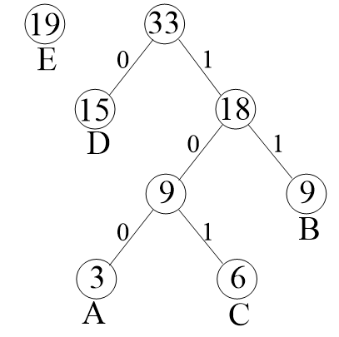
(a) sorting
(b) A & C
(c) B & adjusting
(e) result
(d) D & adjusting

Slide 34
priority_queue
7
5
4
1
2
3
max heap or min heap
A complete binary tree
Given a node at index i, its children are at indices 2i + 1 ((i<<1)+1) and 2i + 2 ((i+1)<<1), and its parent is at index floor((i-1)/2).
Peek, which returns the highest-priority element but does not modify the queue, takes O(1) time.
Insertion and removal take O(log n) time, although building trees from existing sequences of elements takes O(n log n) time.
7 | 5 | 4 | 1 | 2 | 3

Slide 35
STL
stack
queue
priority_queue
set
map
unordered_map
unordered_set
sort()
next_permutation()
nth_element()
https://cplusplus.com/reference/stl/
https://cplusplus.com/reference/algorithm/

Slide 36
Entropy

Slide 37
Add All

Slide 38
Gone Fishing

Slide 39
Enumeration & Greedy
Suppose that fishing ends at the kth lake. Then the fishing time is h*12-sum_{i=1}^{k-1}(ti).
The time can be arbitrarily distributed on the 1~k lakes.
The plan is to find the lake where John can catch the maxinum number of fish for every 5 minutes.

